Slide 1
Estimating river discharge from the Surface Water and Ocean Topography mission: Estimated accuracy of approaches based on Manning’s equation
Elizabeth Clark, Michael Durand, Delwyn Moller, Sylvain Biancamaria, Konstantinos Andreadis, Dennis Lettenmaier, Doug Alsdorf, and Nelly Mognard
UW Land Surface Hydrology Group Seminar
January 13, 2010

Slide 2
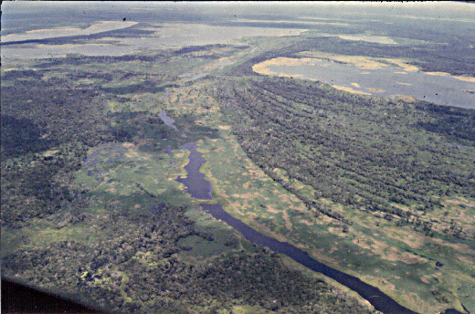
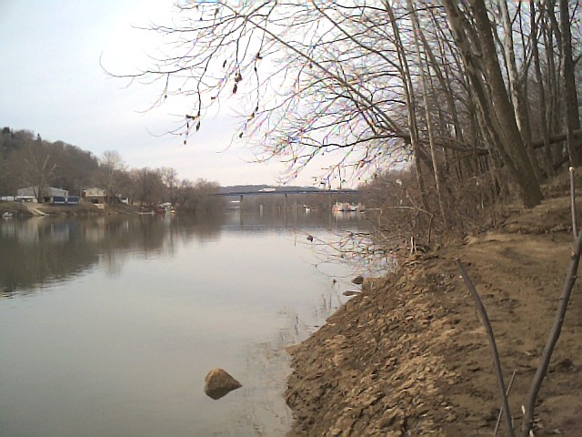
Why do we need SWOT?
Amazon
There are many kinds of rivers
Ohio
Photos: K. Frey, B. Kiel, L. Mertes

Slide 3
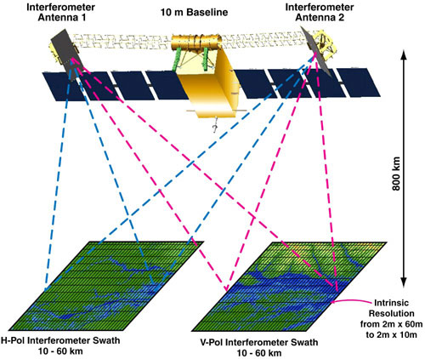
What is SWOT?
Ka-band interferometric SAR, 2 60-km swaths
WSOA and SRTM heritage
Produces heights and co-registered all-weather imagery
Additional instruments:
  Conventional Jason-class altimeter for nadir
  AMR-class radiometer for wet-tropospheric delay corrections
Notes:
Ka band 40-60 GHz = 7.5 mm-5 mm

Slide 4
Review of Existing Measurements
GRACE: S independent of ground conditions, but large spatial scales
Repeat Pass InSAR: dh/dt great spatial resolution, but poor temporal resolution, requires flooded vegetation
Altimetry: h great height accuracy, but no dh/dx and misses too many water bodies
SRTM: h and dh/dx first comprehensive global map of water surface elevations, but only one time snapshot (February 2000)
The radar methods demonstrate that radar will measure h, dh/dx, dh/dt, and area.
Slide: Doug Alsdorf

Slide 5
Science Requirements
Measurement | Required Accuracy (1σ)*
Slope | 1 cm/km, over 10 km downstream distance inside river mask
WSE | 10 cm, averaged over 1 km² area within river mask
Area | 20% for all rivers at least 100 m wide

Slide 6
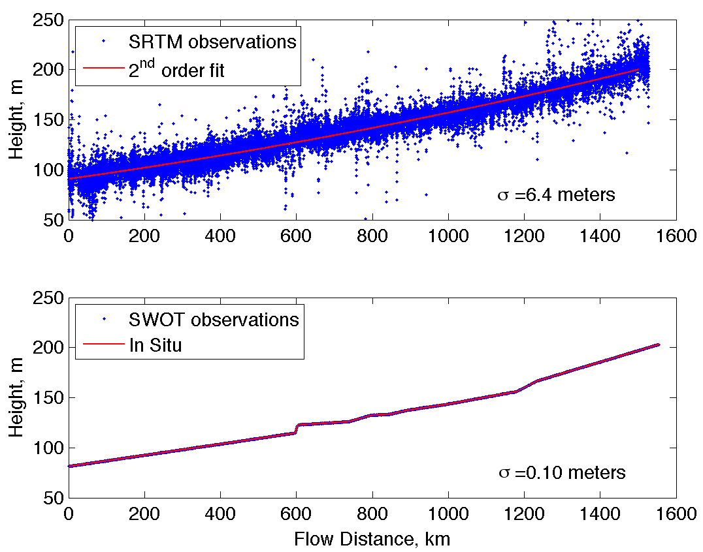
SWOT capability to observe water height
Ohio River SRTM Water elevation measurements
In Situ observ-ations from Carlston, 1969; originally by Army Corps of Engineers
estimated SWOT
Courtesy: Michael Durand, OSU
Notes:
This figure compares the water elevation over the Ohio River from SRTM (top) and expected results for SWOT (bottom). A second-order polynomial was fitted to the SRTM elevations. After subtracting this from the measurements and removing outliers, the standard deviation of SRTM was ~6.4 m. The bottom figure is based on in situ measurements from Carlston, 1969. The measurements were originally made by the Army Corps in 1929.

Slide 7
Estimation of Discharge
Manning’s Equation

Slide 8
Estimation of Discharge
Manning’s Equation
Assuming rectangular cross-section and width >> depth

Slide 9
Estimation of Discharge
Manning’s Equation
Assuming rectangular cross-section and width >> depth
In terms of SWOT observables

Slide 10
Estimation of Discharge
Manning’s Equation
Assuming rectangular cross-section and width >> depth
In terms of SWOT observables

Slide 11
First-order Uncertainties
Assume that Manning’s equation can be linearized using 1st order Taylor’s series expansion

Slide 12
In situ observations
Reach-averaged Value | Mean | Standard Deviation | Minimum | Maximum
Q (m³/s) | 1083 | 9056 | 0.01 | 283170
w (m) | 131 | 193 | 2.9 | 3870
z (m) | 2.39 | 2.36 | 0.10 | 33.00
S | 0.0026 | 0.0052 | 0.000013 | 0.0418
n | 0.034 | 0.046 | 0.008 | 0.664
* 1038 observations on 103 river reaches.
* 401 observations have w>=100 m.
* Courtesy David Bjerklie.

Slide 13
Depth
Ideally would use a priori information
For global application, possible “initial” depth retrieval algorithm from SWOT-based dz, S, w based on continuity assumption and kinematic assumption (Durand et al., accepted):
For a test case on Cumberland River, relative depth error: mean 4.1%, standard deviation 11.2%

Slide 14
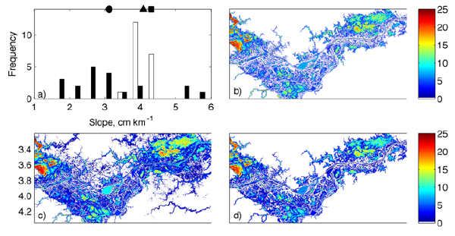
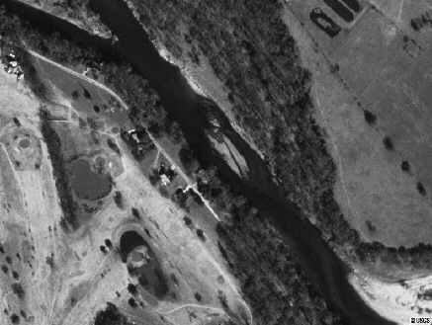
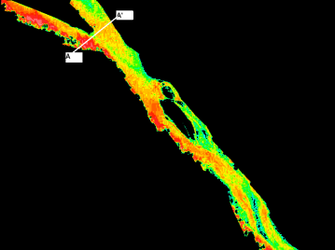
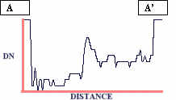
Depth
Other possible approaches not included in analysis:
  Data assimilation into hydrodynamics model (Durand et al. 2008)
  For clear water rivers, can extract from high resolution imagery (like IKONOS; Fonstad, HAB)
IKONOS image
Digital Number
“True”
A Posteriori
A Priori

Slide 15
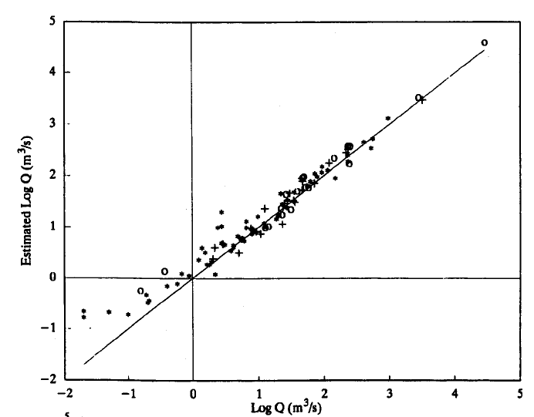
Roughness
Usually calibrated from field measurements or estimated visually in situ.
Some regressions for estimating n from channel form:
  Riggs (1976): n=0.210w^{-0.33}(z₀+dz)^{0.33}s^{0.095}
  Jarrett (1984): n=0.32(z₀+dz)^{-0.16}s^{0.38}
  Dingman and Sharma (1997): n=0.217w^{-0.173}(z₀+dz)^{0.094}s^{0.156}
  Bjerklie et al. (2005) Model 1: n=0.139w^{-0.02}(z₀+dz)^{-0.073}s^{0.15}
Figure: Dingman and Sharma (1997)

Slide 16
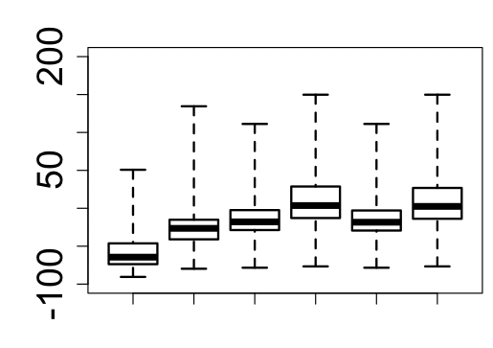
Roughness
Application of regression equation produces large errors in roughness, with roughly 10% mean error and 20-30% standard deviation of error.
Rivers >100 m wide
Relative Error in n (%)
0
J R DS B1 JDS JB1
Mean
Standard deviation
-57%
21%
-27%
23%
-16%
24%
9%
35%
-17%
24%
8%
35%

Slide 17
Width
Classification scheme nontrivial and in development at JPL
Early investigations (Moller et al., 2008) show that the effect of 20 ms water coherence time on relative width errors can be reduced from ~7% averaged over a 100 m long reach to ~4% averaged over reaches between 1-2 km in length.
They also found that as decorrelation approaches infinity, finite pixel sizes provide a lower bound on width bias (~10 m).
Will have to screen out areas with too much layover.

Slide 18
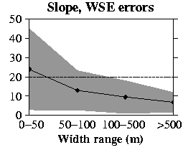
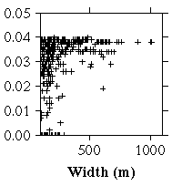
Error in Q due to Errors in Slope and WSE
σ_{s} and σ_{dz} from science requirements
Relative Q error (%)

Slide 19
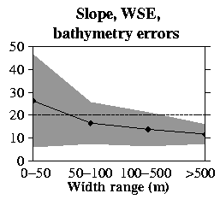
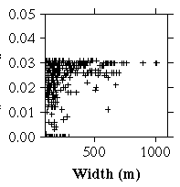
Error in Q due to Errors in Slope, WSE and z₀
σ_{z0}=0.112*z₀
Maximum remaining variance is 0.03
Relative Q error (%)

Slide 20
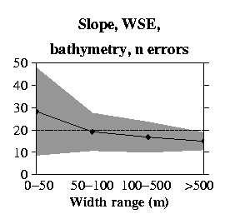
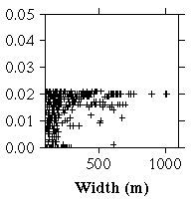
Error in Q due to Errors in Slope, WSE, z₀, and n
From previous slide, the maximum relative error for either n or w, given the other is known perfectly is 17.8%
Goal?: σ_{n}=0.1*n.
This leaves a maximum of 14.2% error for width.
Relative Q error (%)

Slide 21
But not all errors will be their maximum…and some will cancel
Wanted: Probability that errors in Q will exceed 20% given the 1σ errors in S, WSE, z₀, n, and width
Assumed uncorrelated errors and sampled normal distributions with mean 0 and standard deviation 1σ for S, WSE, z₀ and n. Applied a constant 10 m bias for width.
Generated 1000 perturbed realizations for each river reach and computed resulting Q error statistics

Slide 22
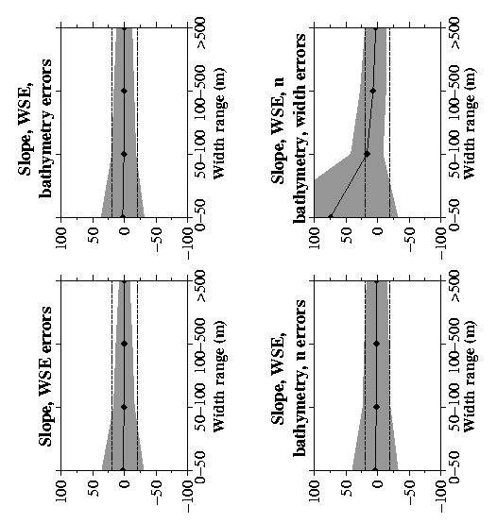
Monte Carlo Results
Same errors for slope, WSE and z₀ (bathymetry) as previously shown, but mean Q errors near zero and standard deviation of Q errors below 20% for rivers wider than 50 m.
σ_{Q}/Q (%)

Slide 23
Monte Carlo Results
Same errors for slope, WSE, z₀, n (10%) as previously shown.
Mean Q errors near zero. One standard deviation of Q error is greater than 20% for rivers less than 50 m wide and near 20% for those 50-500 m wide.
σ_{Q}/Q (%)

Slide 24
Monte Carlo Results
Same errors for slope, WSE, z₀, n (10%) as previously shown.
Width bias of 10 m uniformly included.
Mean Q errors higher than 20% for rivers less than 100 m wide.
One standard deviation of Q error in rivers less than 500 m wide can lead to errors higher than 20%.
σ_{Q}/Q (%)

Slide 25
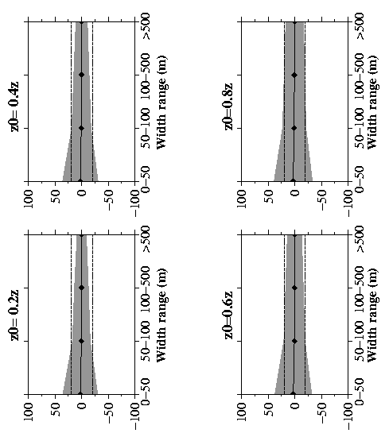
Dependence of Q error on z₀
σ_{Q}/Q (%)
Previously z₀ arbitrarily set to 0.5*z
Q is less sensitive to errors in z₀ if z₀ is small
σ_{Q}/Q (%)

Slide 26
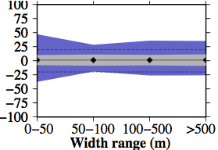
Sensitivity to higher roughness errors
Normally distributed roughness errors varying from 10% (gray) to 20% (blue)
For normally distributed roughness errors ~30-40% the relative Q error standard deviation off the chart
Relative Q error (%)

Slide 27
Conclusions
For the base case of Manning’s equation for 1-D channel flow, discharge can be estimated with accuracies at or near 20% for most rivers wider than 100 m, assuming an improved estimation of n.
Q errors are highly sensitive to errors in total water depth. Estimating depth around low flows would help to limit these errors.

Slide 28
Future Work
Look into roughness error distribution (normal generates physically unrealistic values)
Estimate and incorporate error covariances for SWOT-derived variables
Explore improved algorithms for width and roughness (and bathymetry). Incorporate more spatial information.

Slide 29
Other Avenues
Data assimilation
Use in conjunction with in situ information
Other satellite platforms?

